Slide 1
AIRLINE ENQUIRY SYSTEM

Slide 2
IN-SCOPE
Enquiry
From (Source)
To (Destination)
Duration
Price of Ticket
Airline information
Meal
Checking status of booked tickets
Passenger ID
Passenger Name
Passenger DOB
Passenger Sex
Passenger Flight number
Airport Name
Destination Airport
Departure Date
Departure Time
Arrival Time
Arrival Date

Slide 3
Out-SCOPE
Ticket Availability
Route Description
Book Tickets
Airplane Classes
Luggage Information

Slide 4
TIME FRAME OF PROJECT
14th November - PPT Design
15th November - Database Design and Implementation
16th November - Frontend Design
20th November - Backend Development
26th November - Project Improvement

Slide 5
Developer roles
Aman Khandelwal(U101116FCS007) – Check Status module,JavaScript and its database
Amanpreet Singh(U101116FCS242) - Enquirycontroller ,JavaScript
Hitesh Mittal(U101116FCS045) - Enquiry , homepage
Harshil Sachdeva(U101116FCS044) - Aboutus page, CheckStatus page
Deeptonabho Dutta(U101116FCS030) – Enquiry Page, Servlet designing

Slide 6
technology
Backend Development – Java , Java Servlet , JSP
Frontend Development - HTML , CSS , Bootstrap , JavaScript
Database – MySQL Workbench

Slide 7
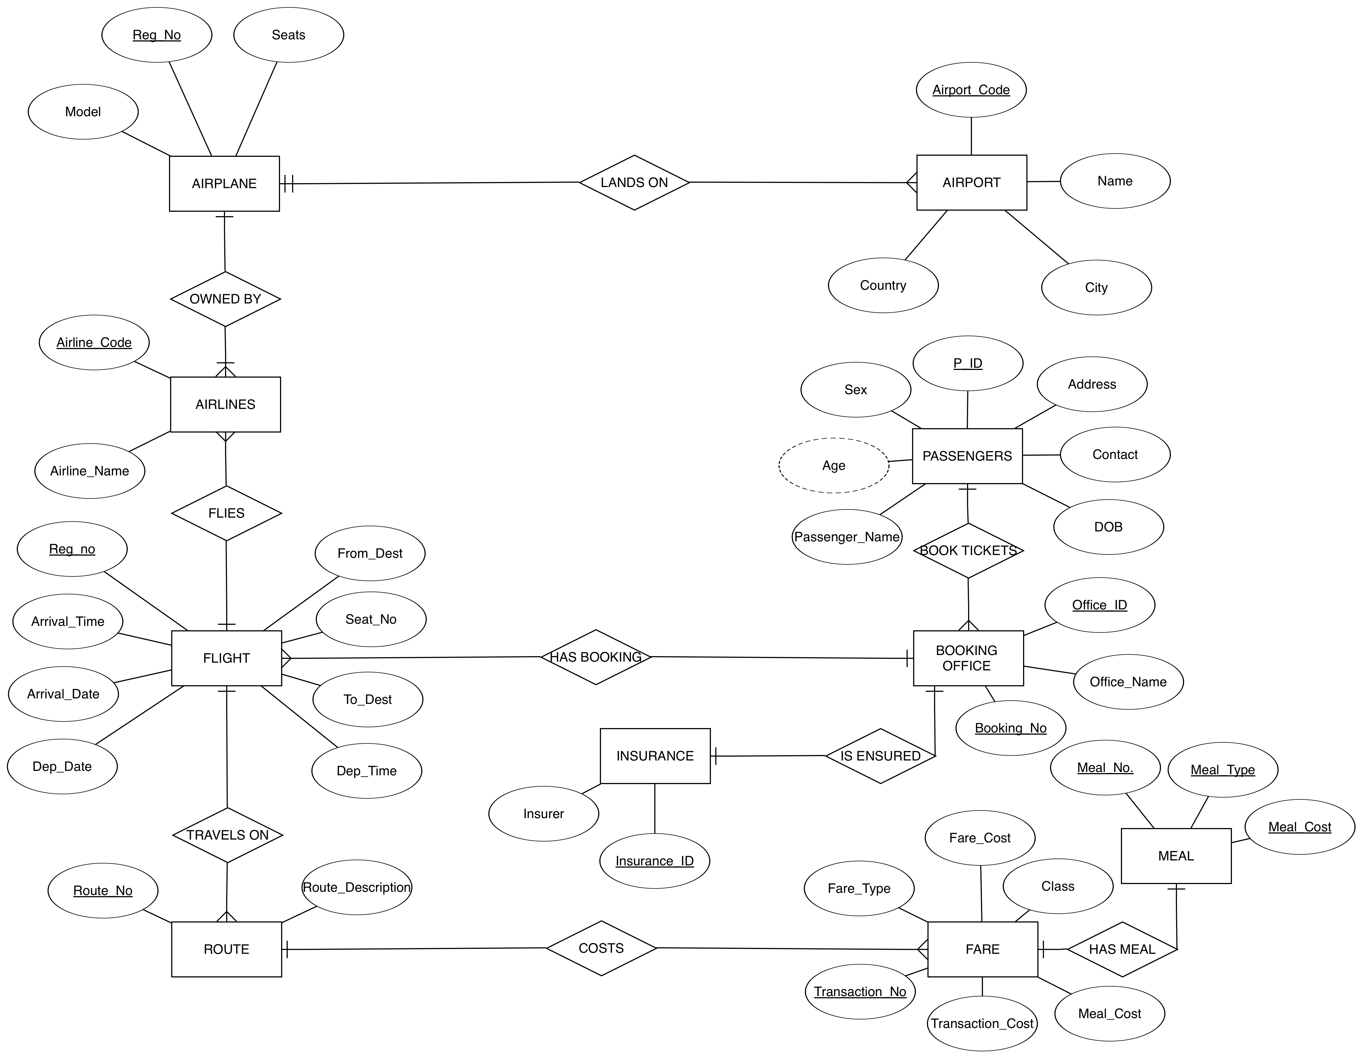
Database design

Slide 8
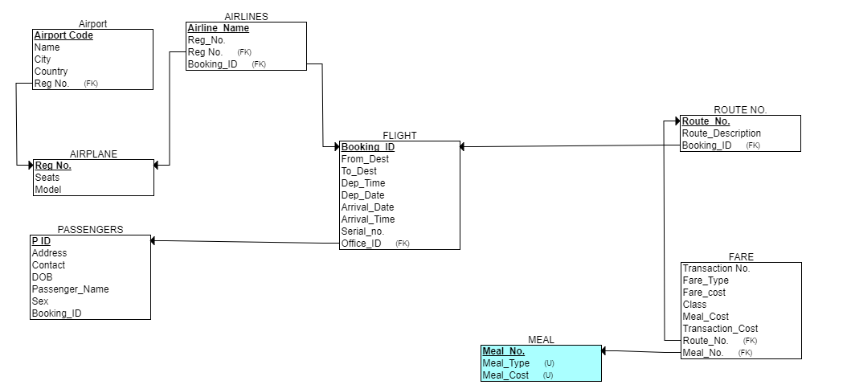
Database design

Slide 9
Thank you

